Slide 1


Slide 2
OPTION SELLING TRACKER
An Interactive Python Trade Management Application for Option Selling with Hedging Support and Record-Keeping
Submitted By:
Bhavya Mehta (92300527128)
Jeel Patel (92300527015)
Aagnik Goswami (92300527012)
Course: BCA – Semester V
Subject: Python
Submitted To:
Prof. Dipak Thanki
Faculty of Computer Application
Marwadi University
Rajkot, Gujarat
Academic Year: 2025–2026

Slide 3

CONTENTS
Chapters | Particulars | Page No.
1 | SYNOPSIS | 1
2 | PREAMBLE General Introduction Module description | 2-3
3 | TECHNICAL DESCRIPTION Hardware Requirement Software Requirement | 4
4 | SYSTEM DESIGN AND DEVELOPMENT Flowchart Screen Design & Coding | 5-7
5 | CONCLUSION | 8
6 | LEARNING DURING SIP | 9-10
7 | BIBLIOGRAPHY Online References Offline References | 11-12

Slide 4
SYNOPSIS
Project Title: Option Selling Tracker.
A CSV-Based Trade Management Tool using Python and Tkinter GUI.
This application allows users to efficiently record, search, update, and manage option selling trades, including hedging positions, by using structured CSV file data storage.
User-friendly interfaces facilitate all core trade tracking operations with validation, prevention of duplicate trades, and easy navigation.
The system is designed to assist retail traders in maintaining accurate, organized trade records without the need for complex database systems.

Slide 5
PREAMBLE
GENERAL INTRODUCTION
Retail traders often engage in option selling to generate income
Manual tracking via spreadsheets is inefficient and error-prone
The tracker simplifies trade tracking using structured CSV storage via a Python GUI application.

Slide 6
PREAMBLE
MODULE DESCRIPTION
Modules:
1. Add Trade
2. Display Trades
3. Search Trade
4. Update Trade
5. Delete Trade
6. Clear All Records

Slide 7
TECHNICAL DESCRIPTION
Hardware Requirements:
Any system capable of running Python
Minimum 512 MB RAM
Minimal disk space required to store CSV trade record files
Software Requirements:
Python 3.x (latest stable version recommended) with Tkinter module included
Any text editor or IDE for code development (e.g., VS Code, PyCharm)
Graphical desktop environment to run the Tkinter GUI application
Python execution environment (command line or terminal) to launch the app

Slide 8
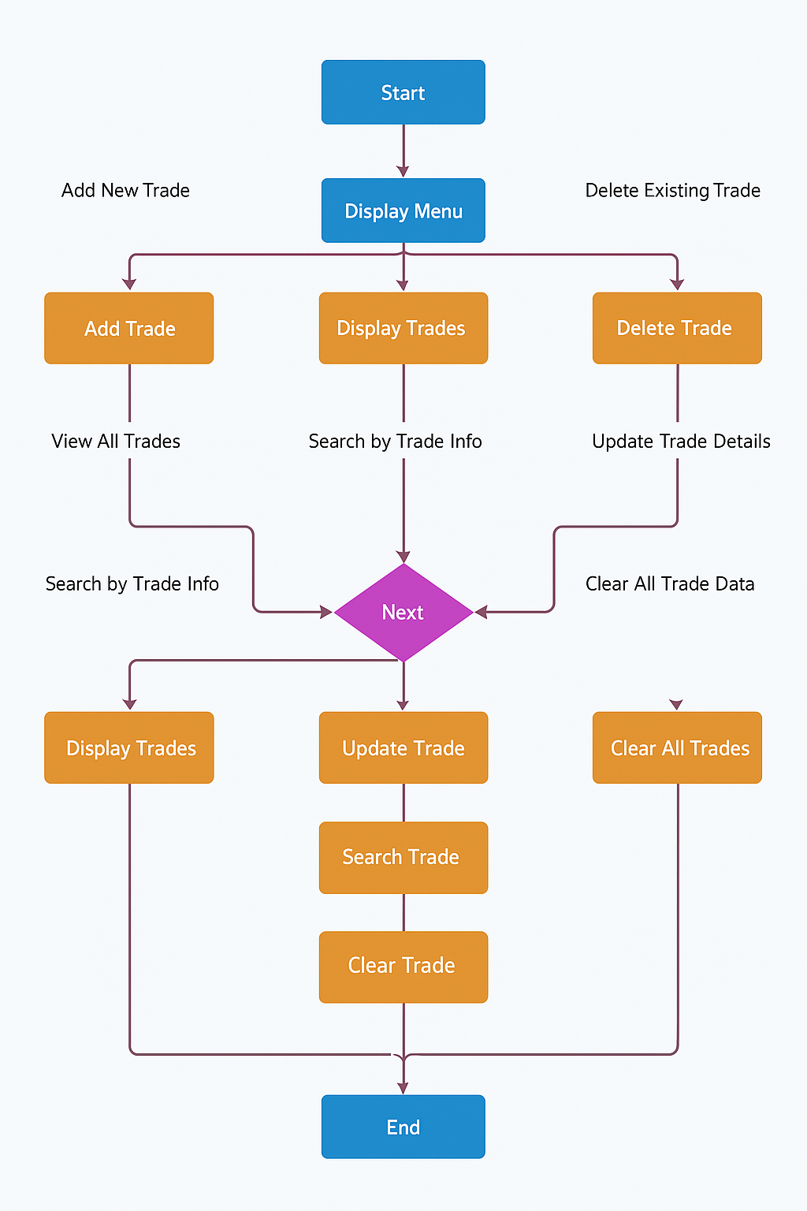
SYSTEM DESIGN
Flowchart

Slide 9

SYSTEM DESIGN
Screen Design
Screen Design (GUI)
The project uses a graphical interface built with Python's Tkinter library. Upon running the application, the user is presented with tabs and forms, providing access to all major functionalities in an organized, user-friendly layout.
Each menu option leads to a respective set of prompts that collect or display data related to option selling trades.

Slide 10
SYSTEM DESIGN
Coding
Python modules used: csv, os, tkinter
Core functions: add_trade(), display_trades(), delete_trade(), update_trade(), search_trade(), clear_all_records(), initialize_file()
Uses CSV file for data storage.

Slide 11
CONCLUSION
Lightweight, efficient trade tracking system for retail traders.
Removes dependency on complex databases.
Future enhancements may include developing a graphical user interface (GUI) for improved usability, integrating analytics for detailed profit and loss summaries, connecting with real-time market APIs for dynamic data input, and migrating to relational databases to support scalability and performance.

Slide 12
LEARNING DURING SIP
Technical
Python programming: modular and structured coding.
CSV file handling: secure read/write operations.
Data validation: unique composite keys.
CLI design: menu-driven interaction.

Slide 13
LEARNING DURING SIP
Domain Knowledge
Trade record-keeping: Highlights the importance of tracking and audit, emphasizing transparent and accurate trade logs.
Hedging: Identifies hedging as a key risk management method in options trading, demonstrating awareness of protective strategies.
Analysis: Notes the necessity of analyzing trade results to assess performance, aligning with professional trading practices.

Slide 14
BIBLIOGRAPHY
Online References
W3Schools – Python File Handling Referred for file operations and input/output techniques.
GeeksforGeeks – Python Projects Used for getting inspiration and coding patterns for CLI-based Python applications.
NSE India – Option Trading Strategies Referred to understand real-world trading strategies and hedging examples.
Real Python – CSV File Operations
Used for best practices and examples on CSV file handling in Python.
Investopedia – Options Selling Explained
Used for best practices and examples on CSV file handling in Python.

Slide 15
BIBLIOGRAPHY
Offline References
Lecture Notes from Option Selling Training Class Personal handwritten notes taken during the stock market classes.
College lecture handouts for Python programming and CLI development.
SIP journal provided by faculty, offering guidance on system design diagrams and documentation practices.

Slide 16


